Slide 1
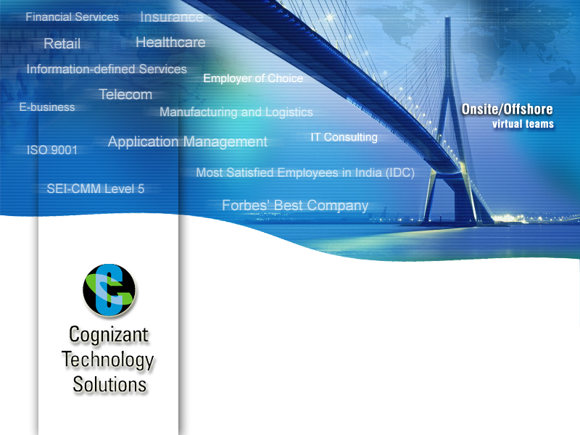
JCAPS Knowledge base
Phani Krishna

Slide 2
Reminders – Streaming Batch eWay
Streaming Data between components
  Data streaming provides a means for interconnecting any two components of the eWay by means of a data stream channel. This channel provides an alternate way of transferring the data between the Batch eWay components.
  Streaming is available between BatchLocalFile and BatchFTP, or BatchLocalFile and BatchRecord.

Slide 3
Reminders – Differences ICAN/JCAPS
Differences between ICAN & JCAPS 5.1.3
ICAN 505 JCAPS 5.1.3
1. Runtime and design time tightly coupled 1.Runtime and design time are decoupled/loosely coupled.
2. Use of multiple logical hosts during runtime. 2. Single logicalhost with multiple domains.
3. Enterprise manager is used for both administration 3. Enterprise Managers are split as two separate and monitoring purpose (http://localhost:12000) services. One is used for administration purpose and other is used for monitoring purpose.
( Administration – http://localhost:12000,
Monitor – http://localhost:15000)
4. Default logger – log4j . Provision for generating 4. Default logger – server.log . Need to configure
service level logs. log4j.properties file.
5. Alerts are stored under 5. Alerts are stored under
/Repository/EventRepositoryDb /eManager/EventRepositoryDb

Slide 4
Reminders - General
The Integration Server is multi-threaded, and when it is started up, it runs on its own thread and it then spawns many threads under it, most of which are configurable as thread pool settings in Enterprise Designer. The IS will use multiple CPU's if they are available
The Java collaborations are stored in the following location:
<JavaCAPS513>/repository/data/objects/versioncontrol/JCEManager/JavaCollaborationDefinition (xml extension )

Slide 5
Reminders – XA / Non-XA Transactions
Differences XA / NON-XA Transactions
XA [ Stands for EXtended Architecture ] NoN-XA
Used for distributed transactions. - Transactions must be single-database.
Known as “Global Transactions”. - Known as “Local Transactions”.
Involves multiple resources. - Involves just one resource.
Involves a coordinating transaction manager, - NO transaction coordinator, and a single
with one or more databases(other resources resource is doing all its transactions
like JMS etc) all involved in a single transaction. work itself.
Most stuff in the world is non-XA - a Servlet or EJB or plain old JDBC in a Java application talking to a single database. XA gets involved when you want to work with multiple resources - 2 or more databases, a database and a JMS connection, all of those plus maybe a JCA resource - all in a single transaction. In this scenario, you'll have an app server like Websphere or Weblogic or JBoss acting as the Transaction Manager, and your various resources (Oracle, Sybase, IBM MQ JMS, SAP, whatever) acting as transaction resources. Your code can then update/delete/publish/whatever across the many resources. When you say "commit", the results are commited across all of the resources. When you say "rollback", _everything_ is rolled back across all resources.
The Transaction Manager coordinates all of this through a protocol called “ Two Phase Commit (2PC)” . This protocol also has to be supported by the individual resources.
In terms of datasources, an XA datasource is a data source that can participate in an XA global transaction. A non-XA datasource generally can't participate in a global transaction (sort of - some people implement what's called a "last participant" optimization that can let you do this for exactly one non-XA item).

Slide 6
Reminders – Two Phase Commit Protocol
The two phases of the algorithm are the commit-request phase, in which a coordinator process attempts to prepare all the transaction's participating processes (named participants or cohorts) to take the necessary steps for either committing or aborting the transaction, and the commit phase, in which, based on voting (either "Yes," commit, or "No," abort) of the cohorts, the coordinator decides whether to commit (only if all vote "Yes") or abort the transaction (otherwise), and notifies the result to the cohorts. The cohorts then follow with the needed actions (commit or abort) with their transactional resources and their respective portions in the transaction's output (if applicable).
The two-phase commit (2PC) protocol is not the same as two-phase locking (2PL), a concurrency control locking protocol.
Basic algorithm
[Commit request phase] or [voting phase]
The coordinator sends a query to commit message to all cohorts and waits until it has received a reply from all cohorts.
The cohorts execute the transaction up to the point where they will be asked to commit. They each write an entry to their undo log and an entry to their redo log.
Each cohort replies with an agreement message (cohort votes Yes to commit), if the transaction succeeded, or an abort message (cohort votes No, not to commit), if the transaction failed.
[Commit phase] or [Completion phase]
a. [Success]
If the coordinator received an agreement message from all cohorts during the commit-request phase:
The coordinator sends a commit message to all the cohorts.
Each cohort completes the operation, and releases all the locks and resources held during the transaction.
Each cohort sends an acknowledgment to the coordinator.
The coordinator completes the transaction when acknowledgments have been received.
b. [Failure]
If any cohort sent an abort message during the commit-request phase:
The coordinator sends a rollback message to all the cohorts.
Each cohort undoes the transaction using the undo log, and releases the resources and locks held during the transaction.
Each cohort sends an acknowledgement to the coordinator.
The coordinator undoes the transaction when all acknowledgements have been received.

Slide 7
Reminders – ESB / Coupling / JBI / SOA
“An ESB is a Web-services-capable middleware infrastructure that supports intelligent program-to-program communication and mediates the relationships among loosely-coupled (SOA) and uncoupled (event-driven) business components.”
Coupling defines the degree of dependencies among services or systems. Thereby, loose coupling is a key attribute of SOA solutions as it allows for the following:
• Characteristics:
> Quick assembly of business solutions by combining services from a variety of systems.
The ability to make changes to a component without affecting others.
Reusing services independently as neither the consumer nor the provider of the service have to know each other.
Services Oriented Architecture (SOA) is a design pattern for distributed software systems that promotes the decomposition of business functions into a series of self contained, service.
Java Business Integration (JBI) is a specification developed under the Java Community Process (JCP) for an approach to implementing a service-oriented architecture (SOA). The JCP reference is JSR 208 for JBI 1.0 and JSR 312 for JBI 2.0.

Slide 8
Reminders – NMR / Service Engines
NMR – Normalized Message Router
What it is:
> A conduit for one component to call another
> Makes calls asynchronous
What it is not:
> Not JMS
> Should not be used for queuing / buffering
> No persistence
> Transaction spans consumer and producer
> No load balancing
Service Engines
• Service Engines are containers that execute business logic
• Business logic gets deployed into service engines
• Service Engines get installed into JBI Runtime
• Examples:
> XSLT, BPEL, EE, IEP, ...

Slide 9
Reminders – Binding Component / Service Unit/Service Assembly
Binding Components
Binding components proxy messages to services hosted somewhere else.
> e.g. HTTP BC, JMS
• Binding components are not APIs to external systems
> JMS BC does not expose JMS API
> File BC does not expose file system API
> e.g. request-reply with FileBC
Service Unit
> Set of files that are deployed into a component
> These files are what make up the application
> Examples: BPEL file, EAR file, XSLT file, Bindings (e.g. wsdl)
Service Assembly
> Collection of Service Units
> a ZIP file that gets deployed into JBI Runtime

Slide 10
Reminders – JBI Portability
JBI Portability Model
• Components should be portable (= Service Engines and Binding Components)
• Service Units are not portable across Service Engines /Binding Components from different vendors
• Example: moving an application from Open ESB to Service Mix:
> Install all Open ESB Service Engines and Binding Components that you used, in Service Mix.
> Deploy the application into Service Mix's runtime.

Slide 11
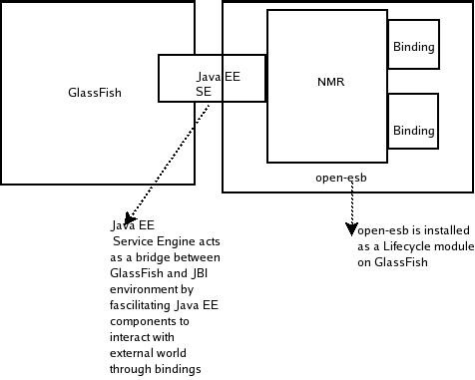
Reminders – Open ESB
What's Open-ESB?
• Sun's open source implementation of JBI Specification as a standard for ESB vendors.
• Allows easy integration of web services to create loosely coupled enterprise class composite applications.
• Improves interoperability and allows a mix-and-match of technologies from various vendors.
• Architectural approach of separating the variant piece (policy) from the invariant piece (business logic) delivers
a mandatory separation of concerns to create and participate in global service collaborations.
GF and Java EE SE

Slide 12
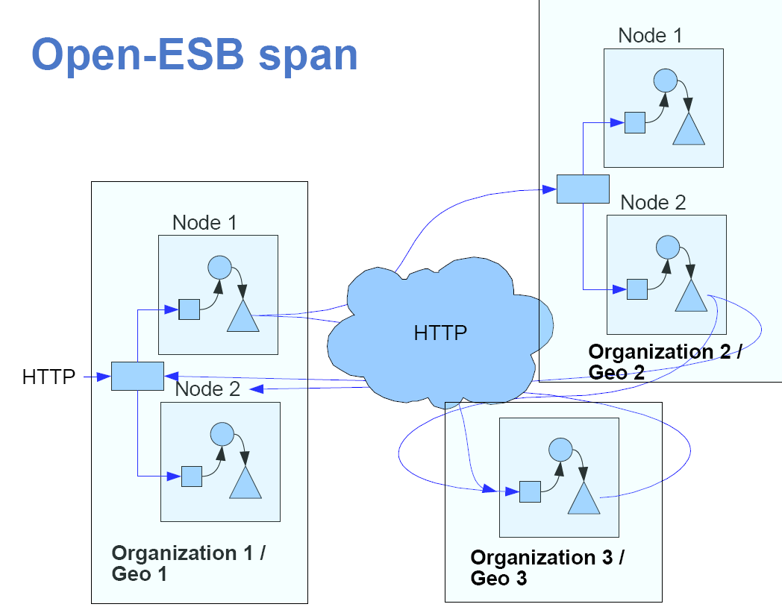
Reminders – Open ESB Clustering
HTTP is the enterprise bus.

Slide 13
Thank You
Phani Krishna

